Slide 1
Language Characteristics

Slide 2
What Drives Programming Language Research?
Curiosity
What other forms can a programming language take?
What other notions of programming are possible?
Productivity
Procedural languages, including C, C++ and Java, are very detailed.
Many source lines imply significant development and maintenance expenses.
Reliability
Too much low-level detail in programs greatly enhances the chance of minor errors. Minor errors can raise significant problems in applications.
Security
Computers are entrusted with great responsibilities. How can we know that a program is safe and reliable enough to trust?
Execution speed
Procedural languages are closely tied to the standard sequential model of instruction execution. We may need radically different programming models to fully exploit parallel and distributed computers.

Slide 3
Desirable Qualities in a Programming Language
Theoretically, all programming languages are equivalent (Why?) If that is so, what properties are desirable in a programming language?
What qualities or characteristics do you want in a programming language?
It should be easy to use.
Programs should be easy to read and understand.
Programs should be simple to write, without subtle pitfalls.
It should be orthogonal, providing only one way to do each step or computation.
Its notation should be natural for the application being programmed.
The language should support abstraction.
You can’t anticipate all needed data structures and operations, so adding new definitions easily and efficiently should be allowed.
The language should support testing, debugging, and verification.

Slide 4
Desirable Qualities in a Programming Language
The language should have a good development environment.
Integrated editors, compilers, debuggers, and version control are a big plus.
Support software can make or break adoption of a language.
The language should be portable, spanning many platforms and operating systems.
The language should be inexpensive to use:
Execution should be fast.
Memory needs should be modest.
Translation should be fast and modular.
Program creation and testing should be easy and cheap.
Maintenance should not be unduly cumbersome.
Components should be reusable.

Slide 5
Programming Paradigms
Programming languages naturally fall into a number of fundamental styles or paradigms.
Procedural Languages
Most of the widely-known and widely-used programming languages (C, Fortran, Pascal, Ada, etc.) are procedural.
Programs execute statement by statement, reading and modifying a shared memory.
This programming style closely models conventional sequential processors linked to a random access memory (RAM).
a = a + 1;
if (a > 10)
b = 10;
else b = 15;
a = a * b;
Why can’t 5 processors each execute one line to make the program run 5 times faster?
Dependencies

Slide 6
Programming Paradigms
Functional Languages
Lisp, Scheme and ML are functional in nature.
Programs are expressions to be evaluated.
Language design aims to minimize side-effects, including assignment.
Alternative evaluation mechanisms are possible, including
Lazy (Demand Driven)
Eager (Data Driven or Speculative)
Object-Oriented Languages
C++, Java, C#, Smalltalk, Pizza and Python are object-oriented.
Data and functions are encapsulated into Objects.
Objects are active, have persistent state, and uniform interfaces (messages or methods).
Notions of inheritance and common interfaces are central.
All objects that provide the same interface are treated uniformly. (Java allows printing any object providing a toString method.)
Subclassing allows a user to extend or redefine part of an object’s behavior without reprogramming all of the object’s definition. (In Java, you can take a LinkedList class and create a subclass in which an existing method (like toString) is redefined, or new operations are added.

Slide 7
Programming Paradigms
Logic Programming Languages
Most programming languages address both the logic of a program (what is to be done) and its control flow (how you encode your algorithms).
A logic programming language, like Prolog, lets programmers focus on a program’s logic without concern for control issue.
These languages have no real control structures, and little notion of “flow of control.”
Execution is search.
What results are programs that are unusually succinct and focused.
It is a fact that an empty list is in order.
inOrder( [] ).
inOrder( [ _ ] ).
inOrder([a,b|c]) :- (a < b), inOrder([b|c]).
It is a fact that a list with one element is in order.
It is a fact that a list is in order if the first two elements are in order
AND the tail of the list is in order.
This is a complete, executable function that determines if a list is in order.
It is naturally polymorphic, and is not cluttered with declarations, variables or explicit loops.
Exercise 1

Slide 8
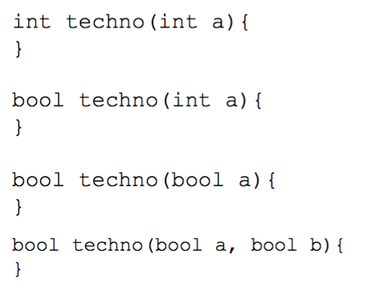
Scoping
A programming language uses a scope to define the lifetime of a variable: where an identifier is active and visible.
Within a scope a name may be defined only once (although overloading may be allowed).
Overloading: Same name, different type.

Slide 9
C-Language Static Scope Example
Global Scope
int x,z;
void A()
{
float x,y;
print(x,y,z);
}
void B()
{
print(x,y,z)
}
Local Scope A
int
float
float
Local Scope B
int
int
undeclared

Slide 10
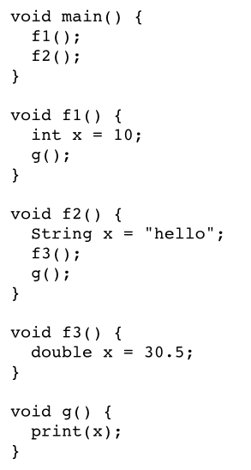
Static vs. Dynamic Scoping
Static
Correspondence between a variable use and declaration is known at compile time.
Dynamic
Correspondence determined at runtime via the runtime stack.
Exercise 2

Slide 11
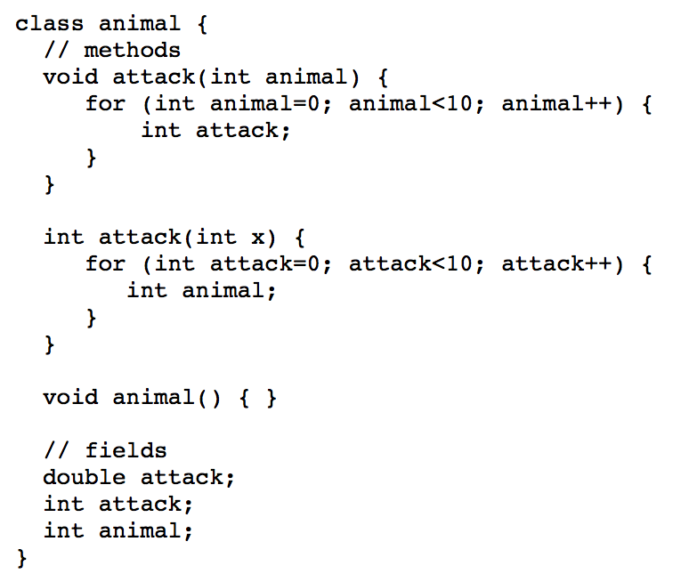
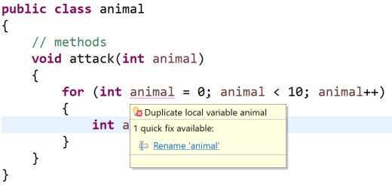
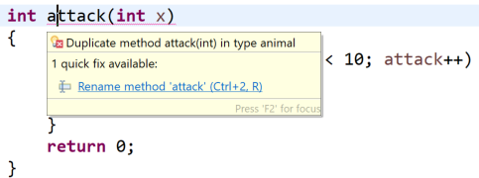
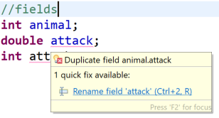
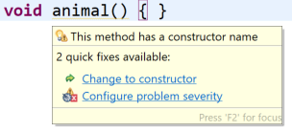
Static Scoping Exercise
What uses and declarations are OK in this Java code?

Slide 12
Static vs. Dynamic Scoping Exercise
State the output with static scoping.
State the output with dynamic scoping.
#include<stdio.h>
int x = 10;
int f()
{
return x;
}
int g()
{
int x = 20;
return f();
}
int main()
{
printf("%d", g());
printf("\n");
return 0;
}
#include<stdio.h>
int x = 10;
int f()
{
return x;
}
int g()
{
int x = 20;
return f();
}
int main()
{
printf("%d", g());
printf("\n");
return 0;
}
Call Stack
x: 20
x: 10
Output: 10
Output: 20

Slide 13
Dynamic Scoping Exercise
void main() {
int x = 0;
f1();
g();
f2();
g();
}
void f1() {
int x = 10;
g();
}
void f2() {
int x = 20;
f1();
g();
}
void g() {
print(x);
}
What does this print, assuming dynamic scoping?
10
0
10
20
0
Exercise 3

Slide 14
Dynamic Scoping
Dynamic scoping makes type checking and variable access harder and more costly than static scoping. (Why?)
However, dynamic scoping does allow a notion of an “extended scope” in which declarations extend to subprograms called within that scope.
Though dynamic scoping may seen a bit bizarre, it is related to virtual functions used in C++ and Java.

Slide 15

Virtual Functions
class C {
void DoIt() { PrintIt(); }
void PrintIt() { System.out.println("C rules!"); }
}
class D extends C {
void PrintIt() { System.out.println("D rules!"); }
void TestIt() { DoIt(); }
}
class Main {
public static void main(String[] args)
{
D dvar = new D();
dvar.TestIt();
C cvar = new D();
cvar.TestIt();
}
}
A function declared in a class, C, may be redeclared in a class derived from C.
We require uniformity of redeclaration: all method redefinitions must have the same method signature and thus all method calls, including those in methods within class C are consistent.
Statically scoped compilation problem.
Exercise 4

Slide 16
Limiting Scope and Lifetime
Limited scopes enhance code readability. Some languages allow an explicit binding of an identifier for a fixed scope.
ML, Scheme, etc.
C, C++, C#, Java, etc.
let
id = val
in
statements
end;
{
type id = val;
statements
}
A declaration may appear wherever a statement or expression is allowed.
Exercise 5

Slide 17

Scope vs. Lifetime
It is usually required that the lifetime of a run-time object at least cover the scope of the identifier. That is, whenever you can access an identifier, the run-time object it denotes better exist.
But, it is possible to have a run-time object’s lifetime exceed the scope of its identifier. An example of this is static (C/C++) or own (ALGOL-60) variables.
#include <cstdio>
void count()
{
static int counter = 100;
printf("%d\n", counter++);
}
int main()
{
for (int i = 0; i < 10; i++)
count();
return 0;
}
Each call to count prints a different value of counter (100, 101, ...)
Variable counter retains its value across calls, but cannot be accessed by other functions:
Exercise 6-7

Slide 18
Blocks
For lightweight, temporary groupings of data, there is also the notion of blocks:
{
float re, im;
re = 0.0; im = 1.0;
}
Blocks are code structures:
Blocks cannot be dynamically created during execution; they are “built into” a program.
They may contain both code and data.
Locals in a block are not visible outside the block.

Slide 19
Aggregators: structs
Many programming languages, including C, C++, C#, Pascal and Ada, have a notion of grouping data together into structs or records.
In C, we can represent a complex number as:
struct complex
{
float re, im;
};
// 2 - i
struct complex num;
num.re = 2;
num.im = -1;
As originally designed, a struct is a data aggregator (with no functions or methods).
(In C++ all structs are classes with public visibility for all fields and function by default.)
structs can be dynamically created, in any number, and included in other data structures (e.g., in an array of structs).
All fields in a struct are visible outside the struct.

Slide 20
Origin of the Class
By adding functions and initialization code to structs, we acquire classes—a blend of structs and blocks.
class Complex
{
float re, im;
Complex (float v1, float v2)
{
re = v1;
im = v2;
}
}
class Complex
{
float re, im;
Complex(float v1, float v2)
{
re = v1;
im = v2;
}
};
Class objects can be created as needed, in any number, and included in other data structures.
They include both data (fields) and functions (methods).
They include mechanisms to initialize themselves (constructors) and to finalize themselves (destructors).
They allow controlled access to members (private and public declarations).

Slide 21
Type Equivalence in Classes
In C, C++ and Java, instances of the same struct or class are type-equivalent, and mutually assignable.
class Point {
int dimensions;
float coordinates[];
Point () {
dimensions = 2;
coordinates = new float[2];
}
Point (int d) {
dimensions = d;
coordinates = new float[d];
}
}
Point plane = new Point();
Point solid = new Point(3);
plane = solid; // OK in Java
class MyClass { ... }
MyClass v1, v2;
v1 = v2; // Assignment is OK
We expect to be able to assign values of the same type, including class objects.
However, sometimes a class models a data object whose size or shape is set upon creation (in a constructor).
We may not want assignment to be allowed.
This assignment is allowed, even though the two objects represent points in different dimensions.

Slide 22
Subtypes
In C++, C#, Python, and Java we can create subclasses—new classes derived from an existing class.
We can use subclasses to create new data objects that are similar (since they are based on a common parent), but still type-inequivalent.
class Point2 extends Point
{
Point2() { super(2); }
}
class Point3 extends Point
{
Point3() { super(3); }
}
Point2 plane = new Point2();
Point3 solid = new Point3();
plane = solid; // Illegal in Java

Slide 23
Parametric Polymorphism
Sometimes we want to create subclasses based on distinct types, and types cannot be passed as parameters. (Types are not values, but rather a property of values.)
We observe this issue in Java, which tries to create general purpose data structures by basing them on the class Object. Since any object can be assigned to type Object (all classes must be a subclass of Object), this works—at least partially.
Using this class, we can create a linked list of any subtype of Object.
But,
We cannot guarantee linked lists are type homogeneous (contain only a single type).
We must cast Object types back into their “real” types when we extract list values.
We must use wrapper classes like Integer rather than int (because primitive types like int are not objects, and are not subclasses of Object).
class LinkedList {
Object value;
LinkedList next;
Object head() { return value; }
LinkedList tail() { return next; }
LinkedList(Object O) { value = O; next = null; }
LinkedList(Object O, LinkedList L)
{
value = O; next = L;
}
}

Slide 24
Parametric Polymorphism
Exercise 8
To build a linked list of ints we would have to wrap each int in an Integer object.
Parametric polymorphism is the solution.
Using this mechanism, we can use type parameters to build a “custom version” of a class from a general purpose class.
C++ allows this using its template mechanism.
Java, post version 8 also allows type parameters.
In both languages, type parameters are enclosed in “angle brackets”:
LinkedList<T>
passes T, a type, to the LinkedList class).
LinkedList l =
new LinkedList(new Integer(123));
To access an element in the linked list, we would need to convert the object to the correct object sub-type (Integer) and then convert to its primitive integer value.
int i = ((Integer) l.head()).intValue();
This is clumsy code at best.
We prefer a mechanism that allows us to create a “custom version” of LinkedList, based on the type we want the list to contain.
LinkedList<Integer> scores =
new LinkedList<Integer>();

Slide 25
Overloading and Ad-hoc Polymorphism
Classes usually allow overloading of method names, if only to support multiple constructors.
Overloading refers to allowing more than one method definition with the same name within a class, as long as the method definitions differ in the number and/or types of the parameters they take.
Overloading is sometimes called “ad hoc” polymorphism, because, to the programmer, it appears that one method can take a variety of different parameter types.
This is not true polymorphism because the methods have different bodies; there is no sharing of one definition among different parameter types. There is no guarantee that the different definitions do the same thing, even though they share a common name.
class MyClass
{
int f(int i) { ... }
int f(float g) { ... }
int f(int i, int j) { ... }
}

Slide 26
Issues with Overloading
Though many languages allow overloading, few allow overloaded methods to differ only on their result types.
(Neither C++ nor Java allow this kind of overloading, though Ada does).
Why is this form of overloading usually disallowed?
It is due to overload resolution (deciding which definition to use) becomes much harder.
class MyClass
{
int f(int i, int j) { ... }
float f(float i, float j) { ... }
float f(int i, int j) { ... }
}
class MyClass
{
int f() { ... }
float f() { ... }
}
is illegal in C++ and Java.
Which definitions of f do we use in each of the three calls? Getting the correct answer can be tricky, though solution algorithms do exist.
This is unfortunate since methods with the same name and parameters, but different result types, could be used to automatically convert result values to the type demanded by the context of call.
int a = f( f(1,2), f(3,4) );

Slide 27
Operator Overloading
Some languages (e.g., C++ and C#), allow operators to be overloaded. You may add new definitions to existing operators, and use them on your own types.
const Rational& Rational::operator+= (long d)
{
this->_numer += d * this->_denom;
reduce();
return *this;
}
class Rational
{
protected:
long _numer;
long _denom;
public:
const Rational& operator=(const Rational& rhs);
const Rational& operator+=(const Rational& rhs);
Rational operator+(const Rational& lhs, const Rational& rhs);
Rational operator/(const Rational& lhs, const Rational& rhs);
…
}
Rational r1{ 1, 2 };
Rational r2{ 1, 4 };
r1 += r2;
std::cout << r1 << "___" << r2;
3 / 4___1 / 4

Slide 28
Parameter Binding
Almost all programming languages have some notion of binding an actual parameter (provided at the point of call) to a formal parameter (used in the body of a subprogram).
There are many different, and inequivalent, methods of parameter binding. Exactly which is used depends upon the programming language in question.
check(computePrimeFactors, 16, {2: 4})
def check(function, inValue, expected):
""" Given a function (as a first-class object, verify if:
function(inValue) == expected
Returns: 1: indicates an error 0: test passed """

Slide 29
Parameter Binding: Pass-By-Value
The formal parameter represents a local variable initialized to the value of the corresponding actual parameter.
private void f(int x)
{
x = -1;
}
public void main()
{
int a = 100;
f(a);
System.out.println(a);
}
x
-1
100
a
100
Exercise 9

Slide 30

Parameter Binding: Pass-By-Result
The formal parameter represents a local variable. Its final value, at the point of return, is copied into the corresponding actual parameter.
Dictionary<TKey, TValue>
Implemented as out variables in C#.
public bool TryGetValue(TKey key, out TValue value);
Dictionary<string, int> grades = new Dictionary<string, int>();
grades.Add("Cecil", 95);
grades.Add("Amy", 80);
grades.Add("Abby", 99);
int grade = -1;
grades.TryGetValue("Amy", out grade);
Console.WriteLine(grade);
Allows a function to 'return' more than one argument.

Slide 31
Parameter Binding: Pass-By-Value/Result
A combination of the value and results modes. The formal parameter is a local variable initialized to the value of the corresponding actual parameter. The formal’s final value, at the point of return, is copied into the corresponding actual parameter.
void f(int x) {
int y = 2 * x + 1;
...
x = y + 10;
}
public static void main(String[] args)
{
int a = 100;
f(a);
print(a);
}
x
y
100
201
211
a
100
211
211
Exercise 10

Slide 32

Parameter Binding: Pass-By-Reference
The formal parameter is a pointer to the corresponding actual parameter. All references to the formal parameter indirectly access the corresponding actual parameter through the pointer.
stack
s
private void popIt(ref Stack<Integer> stack) { stack.pop(); }
public void main()
{
Stack<Integer> s = new Stack<Integer>();
s.push(1);
s.push(2);
System.out.println("Size (pre): " + s.size() +
" top: " + s.peek());
popIt(s);
System.out.println("Size (post): " + s.size() +
" top: " + s.peek());
}
1
2
Exercise 11

Slide 33
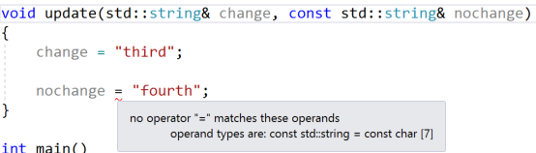
Parameter Binding: Pass-By-Readonly (Const)
A read-only formal parameter cannot be written to.
Either a copy of the actual parameter’s value, or its address, may be used.
C++
reference
const-reference
void update(std::string& change, const std::string& nochange) {
change = "third";
nochange = "fourth";
}
int main()
{
std::string s1 = "First";
std::string s2 = "Second";
update(s1, s2);
std::cout << s1 << std::endl << s2;
return 0;
}

Slide 34
Parameter Binding: Pass-By-Name
The formal parameter represents a block of code (sometimes called a thunk) that is evaluated to obtain the value or address of the corresponding actual parameter. Each reference to the formal parameter causes the thunk to be reevaluated.
void func(value int a,
reference int b,
name int c)
{
a = 1;
b = 2;
print(c)
}
int i = 3, j = 3, k[4][4];
func(i, j, k[i][j]);
6
k
0 1 2 3
0| 0 0 4 0
1| 2 3 0 3
2| 9 0 4 1
3| 0 0 6 0
a
b
c
i
j
3
3
1
k[i][j]
3
2
Exercise 12
k[i][j] → k[3][2]→ 6

Slide 35
Parameter Mode Languages
C: Value mode except for arrays which pass a pointer to the start of the array.
C++: Allows readonly, reference, and value modes.
E.g., int f(int a, int& b, const int&c)
C#: Allows result (out) as well as reference and value modes.
E.g., int g(int a, ref b, out int c)
Java: Scalar types (int, float, char, etc.) are passed by value; objects are passed by reference (references to objects are passed by value).
Fortran: Reference (even for constants!)
Ada: Value/result, reference, and readonly are used.

Slide 36
Why so Many Parameter Passing Modes?
Parameter passing modes reflect different views on how parameters are to be accessed, as well as different degrees of efficiency in accessing and using parameters.
Call by value protects the actual parameter value. No matter what the subprogram does, the parameter cannot be changed.
Call by reference allows immediate updates to the actual parameter.
Call by readonly protects the actual parameter and emphasizes the “constant” nature of the formal parameter.
Call by value/result allows actual parameters to change, but treats a call as a single step (assign parameter values, execute the subprogram’s body, update parameter values).
Call by name delays evaluation of an actual parameter until it is actually needed (which may be never)

Slide 37
Lazy Evaluation: Call by Name
Call by name is a special kind of parameter passing mode. It allows some calls to complete that otherwise would fail.
Consider a call to function f:
f(i, j / 0)
Normally, when j / 0 is evaluated, a divide fault terminates execution. If j / 0 is passed by name, the division is delayed until the parameter is needed, which may be never.
Call by name also allows programmers to create some interesting solutions to hard programming problems.

Slide 38
Lazy Evaluation
Call by name has much of the flavor of lazy evaluation. With lazy evaluation, we do not compute a value but rather a suspension—a function that will provide a value when called.
This can be useful when we need to control how much of a computation is actually performed.

Slide 39
Lazy Evaluation
How do we implement a data structure that represents an infinite list?
Such as: 1, 2, 3, ...
infList(int start)
{
return list(start, infList(start + 1));
}
This computation does not work. Why?
Function calls are evaluated in an eager manner:
infList(1) requires infList(2) be evaluated;
infList(2) requires infList(3) be evaluated;
…

Slide 40
Lazy Evaluation: Suspensions
Consider an implementation using suspensions that does work.
infList(int start)
{
return list(start,
function() {
return infList(start+1);
}
);
}
An infinite list consists of two things:
the first integer in the list and
a suspension function.
When called, the suspension function will give you the 'rest' of the infinite list (via one more value and another suspension function).
The whole list is there, but only as much as you care to access is actually computed.
Exercise 13

Slide 41
Type Equivalence
Programming languages use types to describe the values a data object may hold and the operations that may be performed.
By checking the types of values, potential errors in expressions, assignments and calls may be automatically detected.
Type checking tells us that
123 + "123"
is illegal because addition is not defined for an integer, string combination.
Type checking is usually done at compile-time; that is called static typing.

Slide 42
Type Equivalence
Type-checking may also be done at run-time; this is called dynamic typing.
A program is type-safe if it is impossible to apply an operation to a value of the wrong type.
In a type-safe language, this could never occur:
123 + "123"
+ is never told to add an integer to a string, because its definition does not allow that combination of operands.
Can you have a type-safe program where an operator will still result in a fault (exception)?
1 / 0
In type-safe programs an operator can still see an illegal value but it cannot see operands of the wrong type.
A strongly-typed programming language forbids the execution of type-unsafe programs.
Weakly-typed programming languages allow the execution of potentially type-unsafe programs.

Slide 43
Type Equivalence
The question reduces to whether the programming language allows programmers to “break” the type rules, either knowingly or unknowingly.
Java is strongly typed; type errors preclude execution.
C and C++ are weakly typed; you can break the rules if you wish.
int i;
int* p;
p = (int*) i * i;
p may be used as an integer pointer although multiplication need not produce valid integer pointers.
This is very dangerous code.
If we are going to do type checking in a program, we must decide whether two types, $T_{1}$and $T_{2}$ are equivalent; that is, whether they may be used interchangeably.

Slide 44
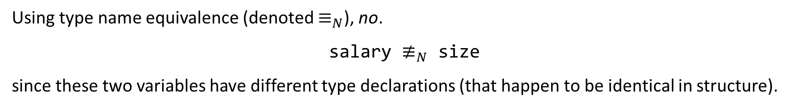
Type Equivalence: Name Equivalence
Two types are equivalent if and only if they refer to exactly the same type declaration.
# Define Types
type Salaries = int[100];
type Sizes = int[100];
# Define Variables
Salaries salary;
Sizes size;
Can we perform the assignment?
salary := size
Is the type of salary equivalent to the type of size?
Using type name equivalence (denoted $≡_{N}$), no.
salary $≢_{N}$ size
since these two variables have different type declarations (that happen to be identical in structure).

Slide 45
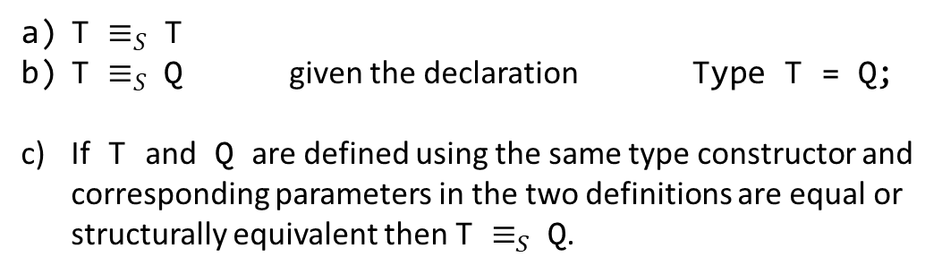
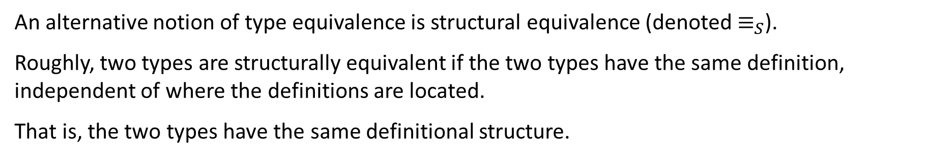
Type Equivalence: Structural Equivalence
An alternative notion of type equivalence is structural equivalence (denoted $≡_{S}$).
Roughly, two types are structurally equivalent if the two types have the same definition, independent of where the definitions are located.
That is, the two types have the same definitional structure.
Formally,
T $≡_{S}$ T
T $≡_{S}$ Q given the declaration Type T = Q;
If T and Q are defined using the same type constructor and corresponding parameters in the two definitions are equal or structurally equivalent then T $≡_{S}$ Q.
A type is structurally equivalent to itself.
A type T is structurally equivalent to Q if defined explicitly.
A type T is structurally equivalent to Q when (recursive) components are structurally equivalent.

Slide 46

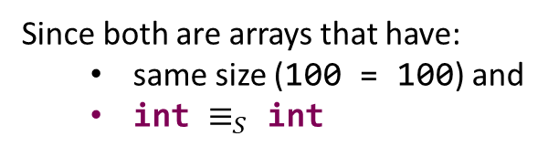
Structural Equivalence
# Define Types
type Salaries = int[100];
type Sizes = int[100];
# Define Variables
Salaries salary;
Sizes size;
salary $≡_{S}$ size
Since both are arrays that have:
same size (100 = 100) and
int $≡_{S}$ int
If the Sizes type was defined with float instead of int, would salary $≡_{S}$ size?
Depends.
Exercise 14

Slide 47
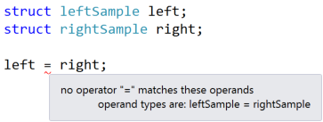

Equivalence in Some Languages
C and C++ use structural equivalence except for structs and classes (where name equivalence is used). For arrays, size is ignored.
struct leftSample
{
int i;
double d;
char c;
};
struct rightSample
{
int i;
double d;
char c;
};
int* inc = new int[5];
inc[0] = 12;
int* decr = new int[10];
decr[0] = 1000;
inc = decr;
std::cout << inc[0] << std::endl;

Slide 48
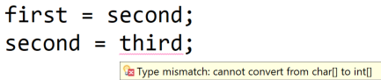
Equivalence in Some Languages
Java uses structural equivalence for scalars. For arrays, it requires name equivalence for the component type, ignoring size.
int[] first = new int[100];
int[] second = new int[1000];
char[] third = new char[10];
For classes it uses name equivalence except that a subtype may be used where a parent type is expected.
The call
is fine since Integer is a subclass of Object.
void subr(Object O) { ... };
subr(new Integer(100));

Slide 49

Automatic Type Conversions
C, C++ and Java also allow various kinds of automatic type conversions. In C, C++ and Java, a float will be automatically created from an int:
float f = 10; // No type error
Also, an integer type (char, short, int, long) will be widened:
int i = 'x';
In C and C++ (but not Java), an integer value can also be narrowed, possibly with the loss of significant bits:
Java
C/C++
char c = 1000000;
Exercise 15

